Slide 1
Digital Systems
18B11EC213
Registers

Slide 2
Contents
Introduction to Registers
Buffer Register
Shift Registers
  serial in/serial out
  serial in/parallel out
  parallel in/serial out
  parallel in/parallel out
Bidirectional Shift Register
Universal Shift Register
Counters using shift registers

Slide 3
Introduction: Registers
An n-bit register has a group of n flip-flops and some logic gates and is capable of storing n bits of information.
The flip-flops store the information while the gates control when and how new information is transferred into the register.
Some functions of register:
  retrieve data from register
  store/load new data into register (serial or parallel)
  shift the data within register (left or right)
Introduction: Registers

Slide 4
Buffer Registers
No external gates.
A 4-bit buffer register. A new 4-bit data is loaded every clock cycle.
Q₃
Q₂
Q₁
Q₀
Q
Q
Q
Q
D
D
D
D
CP
I₃
I₂
I₁
I₀
Q₃ Q₂ Q₁ Q₀ = I₃ I₂ I₁ I₀
Q = I
Simple Registers

Slide 5
Controlled Buffer Register
Instead of loading the register at every clock pulse, we may want to control when to load.
Loading a register: transfer new information into the register. Requires a load control input.
Parallel loading: all bits are loaded simultaneously. Hence it is register with parallel load.

Slide 6
Controlled Buffer Register
Load'.Q₀ + Load. I₀
Load
D
Q
Q₀
I₀
D
Q
Q₁
I₁
D
Q
Q₂
I₂
D
Q
Q₃
I₃
CLK
CLR

Slide 7
Controlled Buffer Register
Operation:
when CLR is LOW, all FFs are reset and output becomes Q = 0000
when CLR is HIGH, register is ready for action.
Now, if Load is HIGH, at the positive edge of next clock pulse the register is loaded. Q₃ Q₂ Q₁ Q₀ = I₃ I₂ I₁ I₀ or Q = I
If Load is LOW, the output of each FF is feedback to its data input. The content of the register remains unchanged in spite of the clock pulses.

Slide 8
Shift Registers
Another function of a register, besides storage, is to provide for data movements.
Each stage (flip-flop) in a shift register represents one bit of storage, and the shifting capability of a register permits the movement of data from stage to stage within the register, or into or out of the register upon application of clock pulses.
Shift Registers

Slide 9
Shift Registers
Basic data movement in shift registers (four bits are used for illustration).
Data in
Data out
Data out
Data in
(a) Serial in/shift right/serial out
(b) Serial in/shift left/serial out
Data in
Data in
Data in
Data out
Data out
(c) Parallel in/serial out
(d) Serial in/parallel out
Data out
(e) Parallel in / parallel out
(f) Rotate right
(g) Rotate left
Shift Registers

Slide 10
Serial In/Serial Out Shift Register
Accepts data serially – one bit at a time – and also produces output serially. It performs shift right operation.
Serial data input
Q₀
Q₁
Q₂
Q₃
Serial data output
D
Q
D
Q
D
Q
D
Q
C
C
C
C
CLK
Serial In/Serial Out Shift Registers

Slide 11
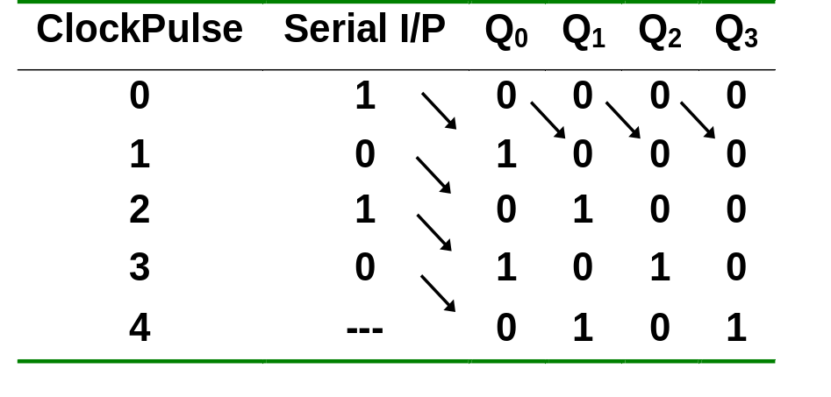
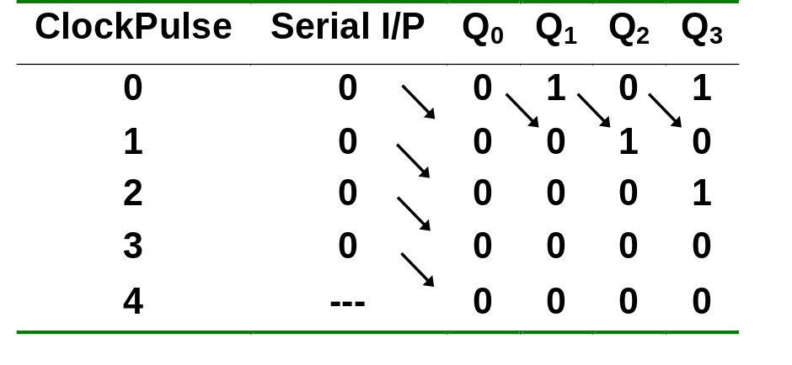
Serial In/Serial Out Shift Register
Serial-transfer example.
Shifting in data 0101 serially
Shifting out data 0101 serially
Serial In/Serial Out Shift Registers

Slide 12
Serial In/Parallel Out Shift Register
Accepts data serially.
Outputs of all stages are available simultaneously.
Data input
D
Q
D
Q
D
Q
D
Q
C
C
C
C
CLK
Q₀
Q₁
Q₂
Q₃
Data input
D
SRG 4
CLK
C
Logic symbol
Q₀
Q₁
Q₂
Q₃
Serial In/Parallel Out Shift Registers

Slide 13
Parallel In/Serial Out Shift Register
Bits are entered simultaneously, but output is serial.
Data input
D₀
D₁
D₂
D₃
SHIFT/LOAD
Serial data out
D
Q
Q₀
D
Q
Q₁
D
Q
Q₂
D
Q
Q₃
C
C
C
C
CLK
SHIFT.Q₀ + SHIFT'.D₁
Parallel In/Serial Out Shift Registers

Slide 14
Parallel In/Serial Out Shift Register
Bits are entered simultaneously, but output is serial.
Data in
D₀
D₁
D₂
D₃
SHIFT/LOAD
SRG 4
Serial data out
CLK
C
Logic symbol
when SHIFT/LOAD is LOW, the data is entered in parallel form into the register .
when SHIFT/LOAD is HIGH, the stored data is shifted out serially from Q₃
Parallel In/Serial Out Shift Registers

Slide 15
Parallel In/Parallel Out Shift Register
Simultaneous input and output of all data bits.
Parallel data inputs
D₀
D₁
D₂
D₃
D
Q
D
Q
D
Q
D
Q
C
C
C
C
CLK
Q₀
Q₁
Q₂
Q₃
Parallel data outputs
Parallel In/Parallel Out Shift Registers

Slide 16
Bidirectional Shift Register
Data can be shifted either left or right, using a control line RIGHT/LEFT (or simply RIGHT) to indicate the direction.
RIGHT/LEFT
Serial data in
RIGHT.Q₀ + RIGHT'.Q₂
D
Q
D
Q
D
Q
D
Q
Q₃
Q₀
Q₁
Q₂
C
C
C
C
Q₀
CLK
Bidirectional Shift Registers

Slide 17
Universal Shift Registers
4-bit bidirectional shift register with parallel load.
Parallel outputs
Q₄
Q₃
Q₂
Q₁
Clear
Q
Q
Q
Q
D
D
D
D
CLK
s₁
4x1 MUX
4x1 MUX
4x1 MUX
4x1 MUX
s₀
3 2 1 0
3 2 1 0
3 2 1 0
3 2 1 0
Serial input for shift-right
Serial input for shift-left
I₄
I₃
I₂
I₁
Parallel inputs

Slide 18
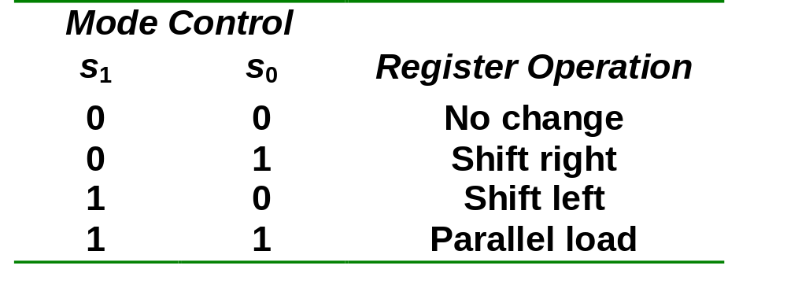
Universal Shift Registers
4-bit bidirectional shift register with parallel load.
Universal Shift Registers

Slide 19
Shift Register Counters
Shift register counter: a shift register with the serial output connected back to the serial input.
They are classified as counters because they give a specified sequence of states.
Two common types: the Johnson counter and the Ring counter.
Shift Register Counters

Slide 20
Ring Counter
One flip-flop (stage) for each state in the sequence.
The output of the last stage is connected to the D input of the first stage.
An n-bit ring counter cycles through n states.
No decoding gates are required, as there is an output that corresponds to every state the counter is in.
Ring Counters

Slide 21
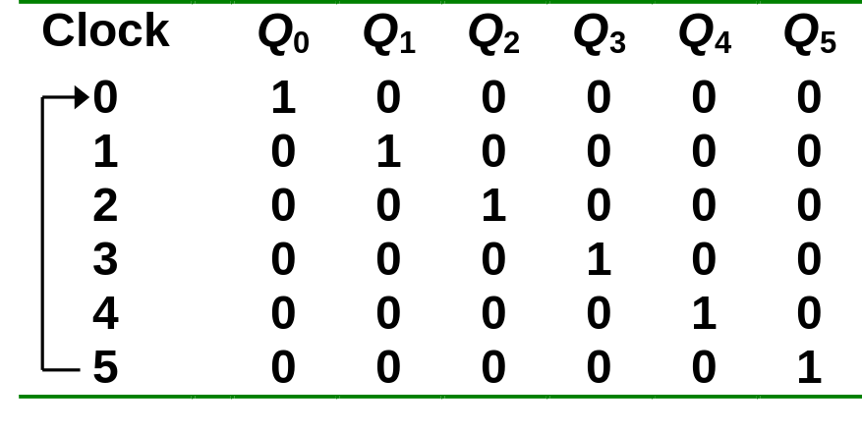
Ring Counter
Example: A 6-bit (MOD-6) ring counter.
PRE
Q₀
Q₁
Q₂
Q₃
Q₄
Q₅
D
Q
D
Q
D
Q
D
Q
D
Q
D
Q
CLR
CLK
100000
000001
010000
000010
001000
000100
Ring Counters

Slide 22
Johnson Counter
The complement of the output of the last stage is connected back to the D input of the first stage.
Also called the twisted-ring counter.
Require fewer flip-flops than ring counters but more flip-flops than binary counters.
An n-bit Johnson counter cycles through 2n states.
Require more decoding circuitry than ring counter but less than binary counters.
Johnson Counters

Slide 23
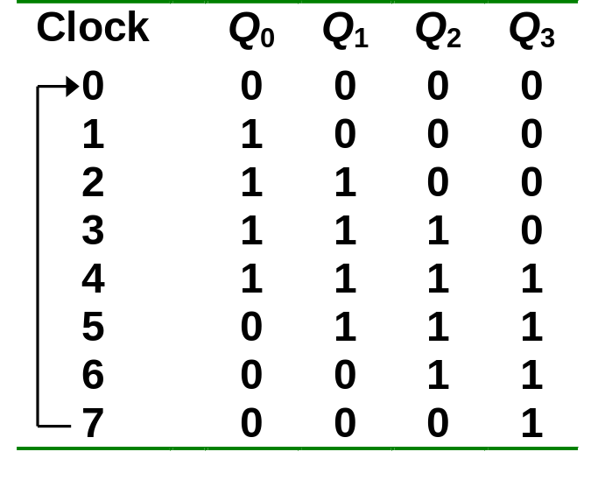
Johnson Counter
Example: A 4-bit (MOD-8) Johnson counter.
Q₀
Q₁
Q₂
D
Q
D
Q
D
Q
D
Q
Q'
Q₃'
CLR
CLK
0000
0001
1000
0011
1100
0111
1110
1111
Johnson Counters

Slide 24
References
A. Anand Kumar, “Fundamentals of Digital Circuits”, PHI, Fourth Edition.
S. Salivahanan and S. Arivazhagan, “Digital circuits and design”, Vikas Publishing House PVT Limited, Fifth edition.

